Slide 1
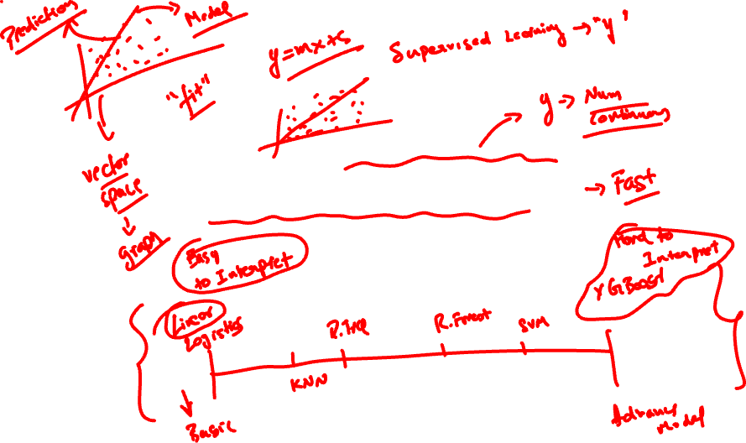
LINEAR REGRESSION

Slide 2
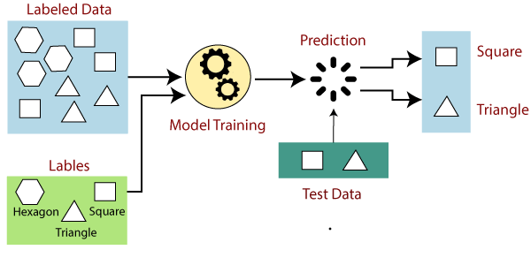

RELOOK AT SUPERVISED LEARNING
Training a machine learning task for every input with a corresponding target is called supervised learning.
Labeled Data
Prediction
Square
Triangle
Model Training
Labels
Test Data
Hexagon
Square
Triangle
Source: Blog
Notes:
Ref: https://kalebujordan.com/wp-content/uploads/2020/04/main-qimg-de3c7fc5459dc5f003fdba9080ec23a0.png

Slide 3



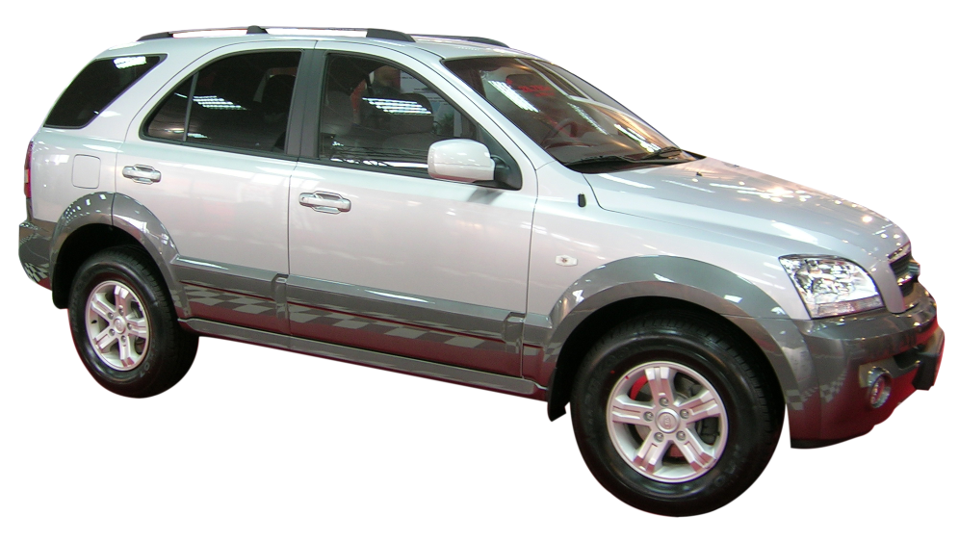
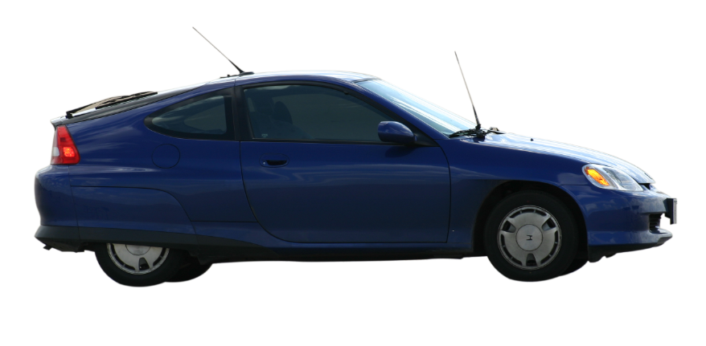

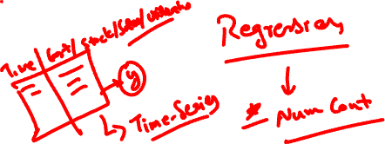
LET US LOOK AT AN EXAMPLE ON SUPERVISED LEARNING
Prediction of ‘price’ of used cars
Price?
3,45,000
2,15,000

Slide 4


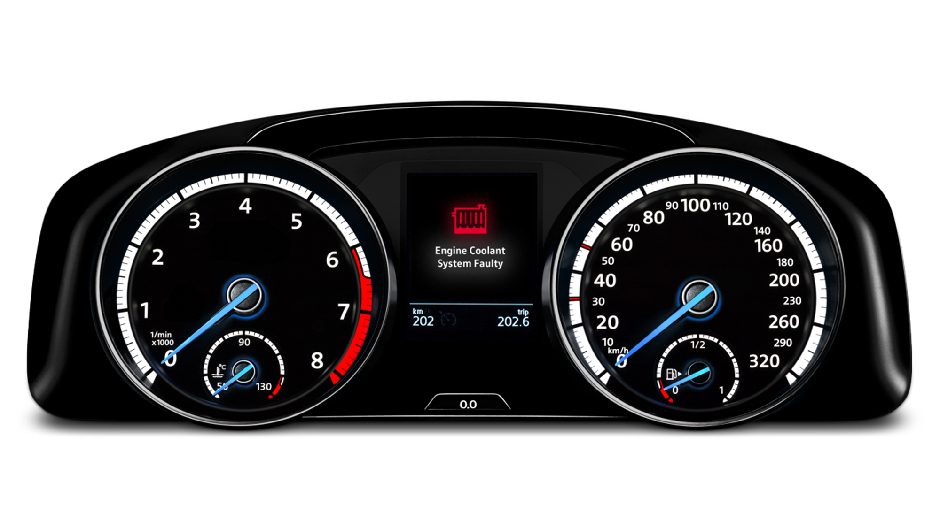
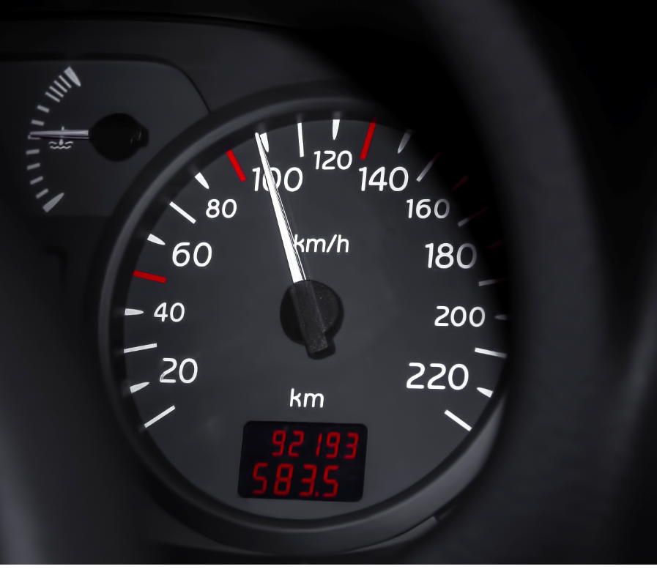





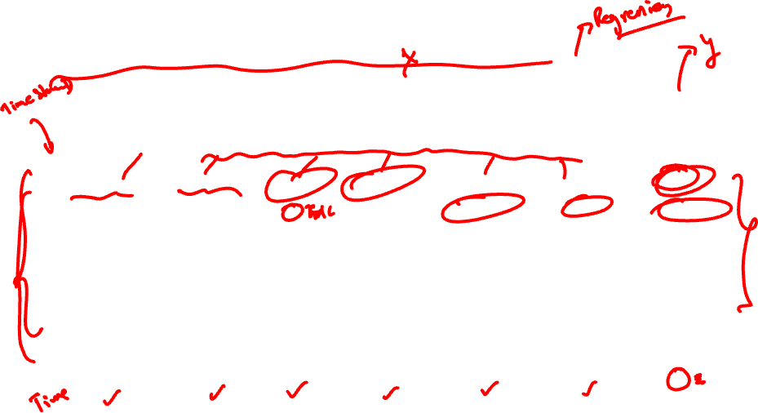
FACTORS AFFECTING THE PRICE OF A CAR
Year of Registration | Vehicle Type | Mileage | Kilometers | Brand | Fuel Type | Price
2016 | SUV | 32 | 125000 | Hyundai Creta | Petrol | 345000
2015 | Hatchback | 24.07 | 34000 | Maruti Alto K10 | Diesel | 215000
2014 | Hatchback | 26 | 230000 | Honda Civic | Petrol | 300000
2017 | Hatchback | 20.85 | 17500 | Wagon R | Diesel | 175000
2017 | Sedan | 28.09 | 54450 | Maruti Ciaz | Diesel | 295000
2016 | Hatchback | 27.6 | 76000 | Maruti Celerio | Diesel | 280000
2016 | Sedan | 25.83 | 15900 | Ford Aspire | Diesel | 235000
2016 | Sedan | 22 | 15775 | Swift Dezire | Petrol | ?

Slide 5
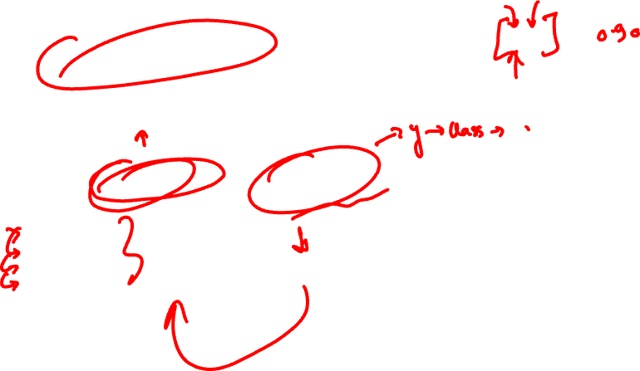
SUPERVISED LEARNING FOR PRICE PREDICTION OF USED CARS
Predict the price of a used car
Has predictor (independent) variables and an outcome (dependent) variable.
Predictor or independent variables | Dependent variable
Mileage(km/lit) Kilometers Fuel Type Vehicle Type Brand | Price(in lakh)
Mileage(km/lit)
Kilometers
Fuel Type
Vehicle Type
Brand

Slide 6

Predict values of a continuous dependent variable using independent explanatory variable(s).
y
WHAT IS REGRESSION?
dependent variable
x

Slide 7
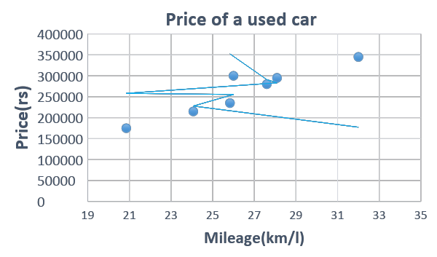
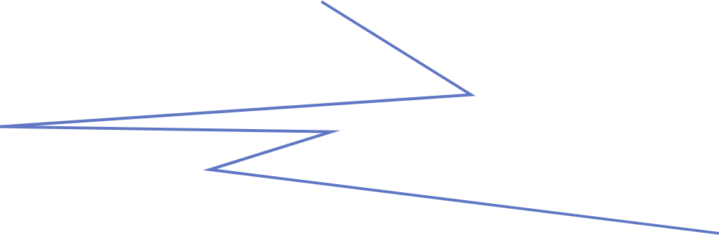

REGRESSION EXPLAINED FURTHER WITH AN EXAMPLE
Predict values of the price of a car using independent explanatory variable(s) mileage.
Price of a used car
400000
Predict price of a car
350000
300000
250000
200000
150000
100000
Using independent variable Mileage
50000
0
19
21
23
25
27
29
31
33
35
Mileage (km/l)

Slide 8




REGRESSION USE CASES
Real estate
Model house prices as a function of home’s living area, number of bedrooms, bathrooms, and lot size
Marketing
Model relationship between online advertising costs and monthly e-commerce sales
Real estate
Model house prices as a function of home’s living area, number of bedrooms, bathrooms, and lot size
Marketing
Model relationship between online advertising costs and monthly e-commerce sales

Slide 9




REGRESSION USE CASES
Medicine
Forecast medical expenses for insured population based on attributes like age, gender, smoker, BMI
Weather
Model relationship between crop yield based on amount of rainfall
Medicine
Forecast medical expenses for insured population based on attributes like age, gender, smoker, BMI
Weather
Model relationship between crop yield based on amount of rainfall

Slide 10
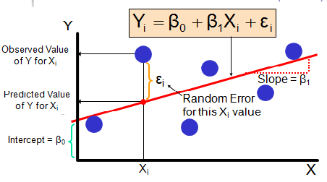


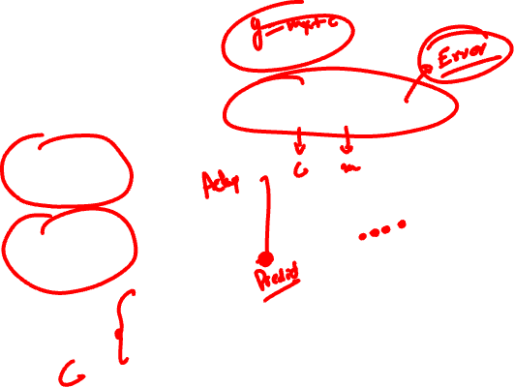
Form of regression that models linear relationship between dependent and independent variables.
Yi=B0 + B1Xi + ei
WHAT IS LINEAR REGRESSION?
Y = + X +
Y
Observed value
of Y for Xi
ẞ₁
Slope =
Predicted value
of Y for Xi
Random Error
For this Xi value
ẞ₀
Intercept =
Xi
X
p(y)=ẞ₀+ẞ₁X
Source: Blog
Notes:
Ref: https://datascience696.files.wordpress.com/2016/08/regressioncurv.png

Slide 11

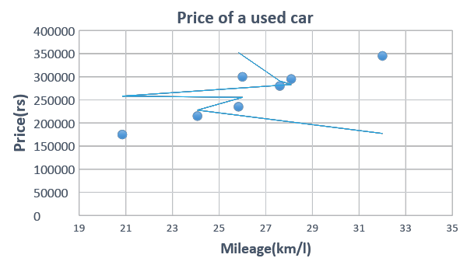
LINEAR REGRESSION IN ACTION
Mileage and Price are linearly related to each other.
Mileage is dependent & Price is independent variable.
Price of a used car
400000
350000
300000
250000
Predict Price
using mileage
Price(rs)
200000
Predict Price using mileage
150000
100000
50000
0
19
21
23
25
27
29
31
33
35
Mileage (km/l)

Slide 12




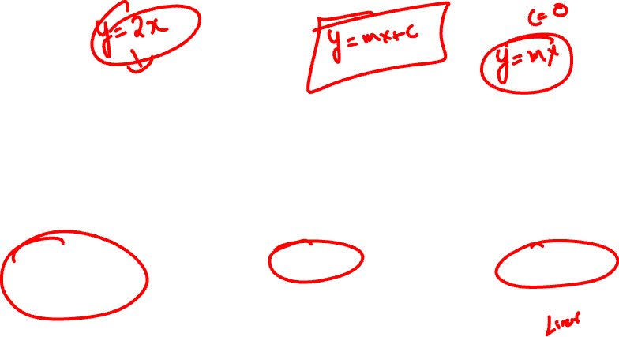
Ease of implementation
Powerful
Easily scalable
Ease of implementation
Powerful
Notes:
Source: Couldn’t find the source of this image. This can be recreated with simple images.

Slide 13
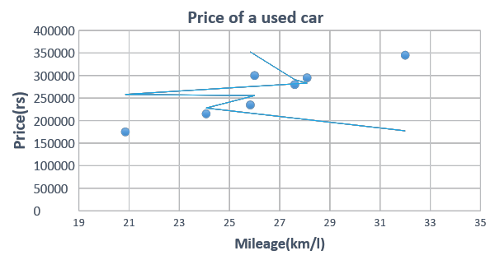
What is the price of a car when mileage is 27 km/l?
Price of a used car
400000
CALCULATION OF DEPENDENT VARIABLE USING INDEPENDENT VARIABLE VALUE
350000
300000
250000
Price(rs)
200000
150000
100000
50000
0
19
21
23
25
27
29
31
33
35
Mileage (km/l)

Slide 14
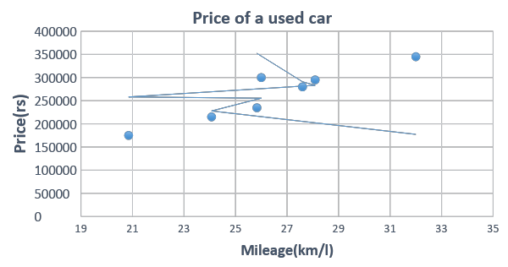
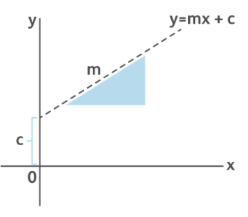
LET US FIND THE EQUATION OF A LINE
Price of a used car
400000
Y = mx + C
y
350000
300000
250000
m
Price(rs)
200000
150000
c
100000
x
50000
0
0
19
21
23
25
27
29
31
33
35
Mileage (km/l)
The equation says that price of a car increases by 15691 (rs) for each additional 1km/l of mileage.

Slide 15
DESCRIBE EQUATION OF A LINE
Y = + X +
Y
Observed value
of Y for Xi
ẞ₁
Slope =
Predicted value
of Y for Xi
Random Error
For this Xi value
ẞ₀
Intercept =
Xi
X
Source: Blog
p(y)=ẞ₀+ẞ₁X

Slide 16

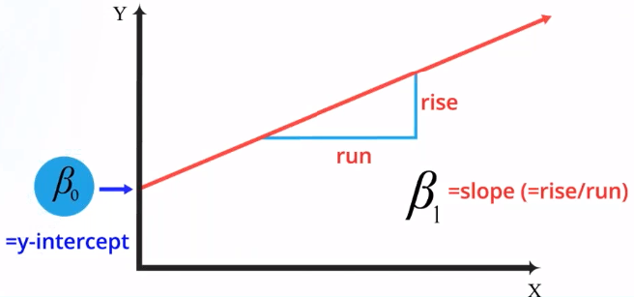
EXTENDING EQUATION OF A LINE TO LINEAR REGRESSION
How equation of Linear Regression looks
Input variable
Intercept
Predicted value for y
Error term
Slope of regression line
Y
rise
run
=y-intercept
= slope (=rise/run)
X

Slide 17
LET’S TAKE A USE CASE TO UNDERSTAND THE EQUATION

Slide 18



PIZZA PARLOR
PIZZA
Students contribute to most amount of sales
Students contribute to most amount of sales

Slide 19




Student population(1000s) | Quarterly Sales($1000s)
2 | 58
6 | 105
8 | 88
10 | 118
12 | 117
16 | 137
20 | 157
24 | 169
22 | 149
26 | 202
Notes:
Edit: any image with same pictorial representation can be used.

Slide 20
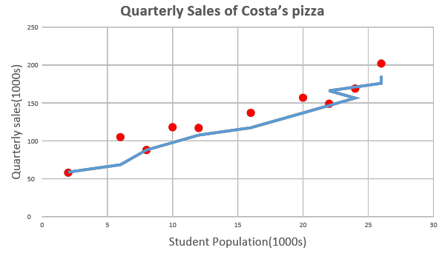
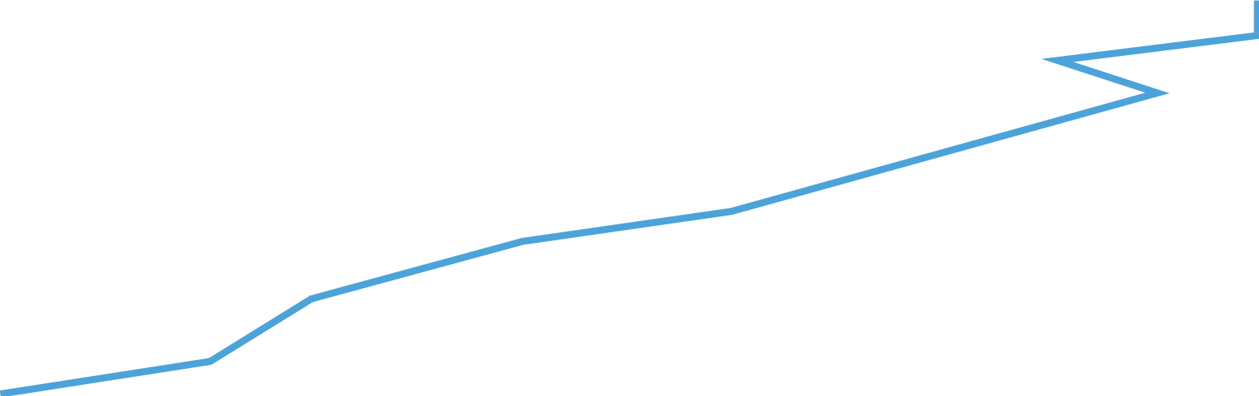

LET’S PLOT QUARTERLY SALES AGAINST STUDENT POPULATION
Quarterly Sales of Costa’s pizza
250
They follow a linear relationship,
thus we can perform linear regression
200
150
Quarterly sales(1000s)
100
50
0
0
5
10
15
20
25
30
Student Population (1000s)

Slide 21
SLOPE HAS GREAT IMPACT ON YOUR MODEL (ẞ1)
rise
run
= slope (=rise/run)
Slope of regression line

Slide 22
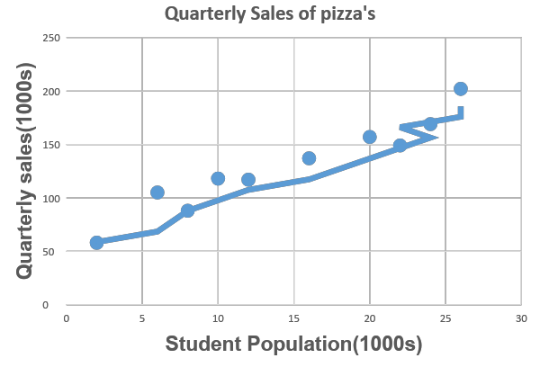

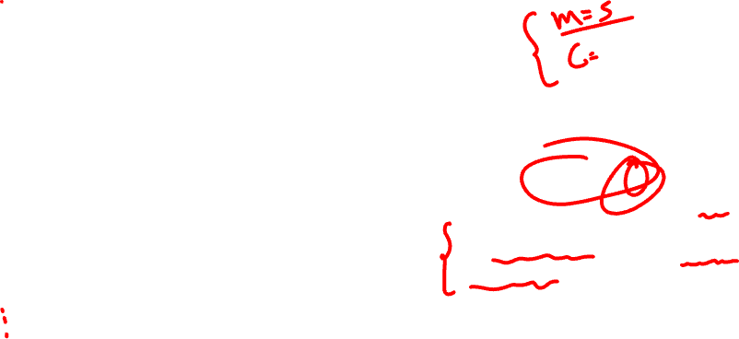
SLOPE HAS GREAT IMPACT ON YOUR MODEL (ẞ1)
Quarterly Sales of Costa’s pizza
250
200
Slope b1 = 5
150
An increase in “Student Population(1000s)” is associated with an increase of $5000 in expected sales.
Quarterly sales(1000s)
100
50
0
0
5
10
15
20
25
30
Student Population (1000s)

Slide 23

UNDERSTAND MODEL’S INTERCEPT WITH AN EXAMPLE (ẞ0)
Y
rise
run
= slope (=rise/run)
=y intercept
Intercept
X

Slide 24

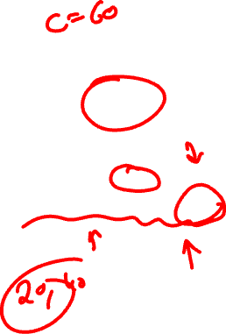
QUARTERLY PIZZA SALES IN ABSENCE OF STUDENT POPULATION (ẞ0)
Quarterly Sales of Costa’s pizza’s
250
200
Intercept b0 = 60
150
Quarterly sales(1000s)
b0 indicates that when
“Student Population(1000s)” is 0
the “Quarterly Sales($1000s)” is 60.
100
50
0
0
5
10
15
20
25
30
Student Population (1000s)

Slide 25


LET US TALK ABOUT ERRORS OR RESIDUALS
Random Error

Slide 26
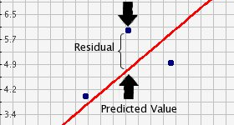
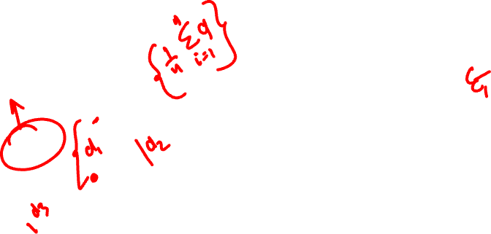
WHAT ARE RESIDUALS?
Observed value
Observed value
6.5
5.7
Residual
Residual is the difference between observed
value of dependent variable and predicted value.
4.9
4.2
Predicted Value
3.4

Slide 27
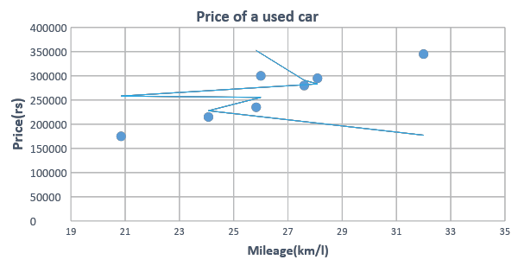
RESIDUALS ILLUSTRATED WITH AN EXAMPLE
Price of a used car
400000
350000
300000
250000
Price(rs)
200000
150000
100000
50000
0
19
21
23
25
27
29
31
33
35
Mileage (km/l)

Slide 28
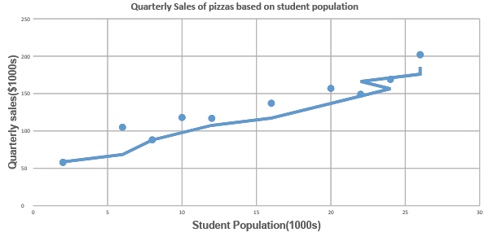
HOW FAR IS PREDICTED PIZZA SALES FROM ACTUAL PIZZA SALES (ERROR)
Quarterly Sales of Costa’s pizza
250
200
Regression Line
150
Observed values
Quarterly sales(1000s)
Residual=
Observed values-Predicted values
100
50
0
0
5
10
15
20
25
30
Student Population (1000s)

Slide 29
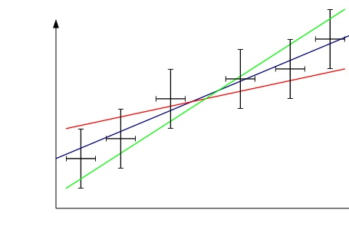

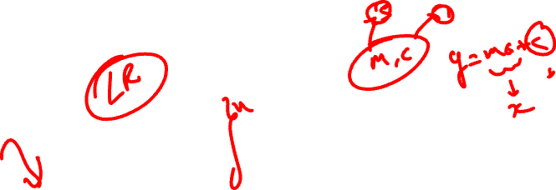
WHAT IS THE BEST FITTING LINE: LET US EVALUATE
Line of best fit
Goal: Find the best slope and intercept that fits data points
Solution: Minimize residual errors.

Slide 30



HOW GOOD OR BAD YOUR MODEL IS: LET US EVALUATE
The following metrics are used to measure model performance.
MAE: Mean absolute Error
MSE: Mean Squared Error
RMSE: Root Mean Squared Error

Slide 31
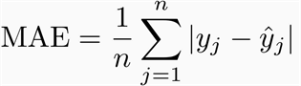
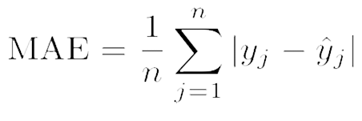
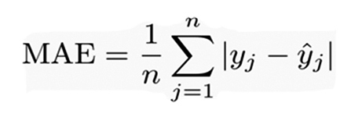
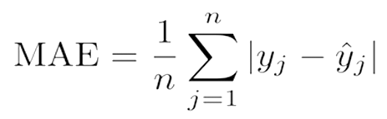
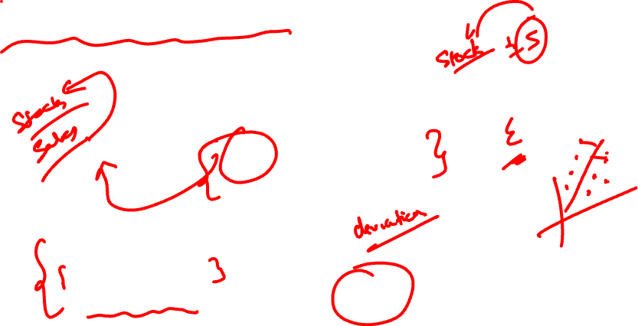
MEAN ABSOLUTE ERROR(MAE)
MAE is the average absolute difference between actual and predicted values.
Characteristics:
Neutral to outliers
Error is in same units as that of the data points.

Slide 32
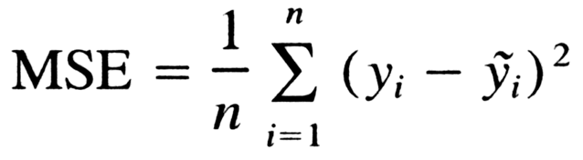
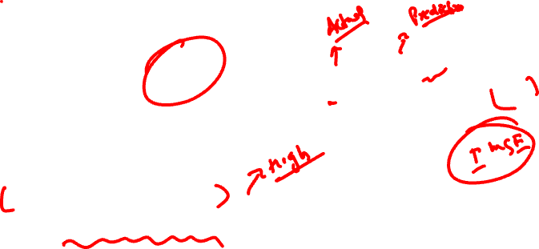
MEAN SQUARED ERROR(MSE)
MSE is the average squared difference between actual and predicted values.
Characteristics:
Accounts impact of outliers.
Error is NOT in same unit as that of the data points .

Slide 33
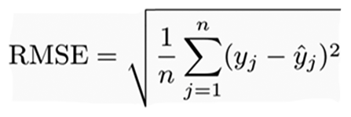
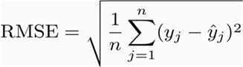
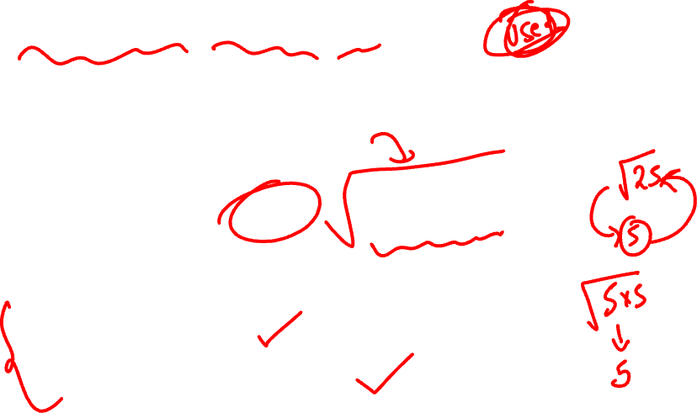
ROOT MEAN SQUARED ERROR(RMSE)
RMSE is the square root of the average squared difference between actual and predicted values.
Characteristics:
Accounts impact of outliers.
Error is in same unit as that of the data points.

Slide 34
Important Assumptions in Linear Regression

Slide 35

A Linear relation between dependent & independent variables.
No multicollinearity between independent variables.
Residuals(errors) are homoscedastic.
Residuals are normally distributed.
ASSUMPTIONS IN LINEAR REGRESSION

Slide 36
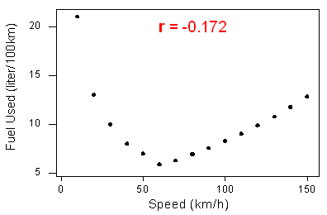

WHAT IF THE RELATIONSHIP IS NOT LINEAR AT ALL
ŷ
20
r = -0.172
20
ŷ
15
15
Fuel Used
(liter/100km)
Fuel Used
(liter/100km)
10
10
5
5
0
50
100
150
0
50
100
150
Speed (km/h)
Speed (km/h)
Regression line doesn’t capture much information due to distribution of data points.
A non-linear approach works better in this scenario.
Regression line doesn’t capture much information due to distribution of data points.
A non-linear approach works better in this scenario.

Slide 37
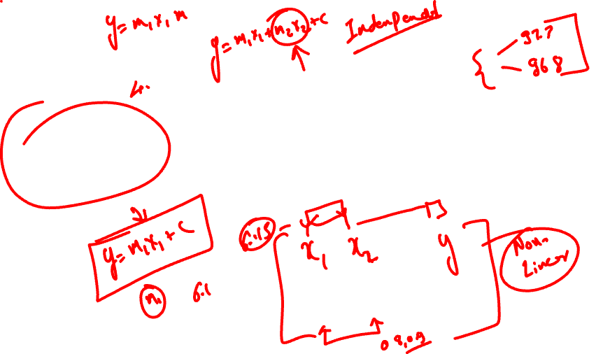
ASSUMPTION 2: MULTI COLLINEARITY
A statistical phenomenon where,
Independent explanatory variables are highly positively correlated with one another.
Highly correlated independent variables explain the same variance about dependent variable, thus introducing redundancy.

Slide 38
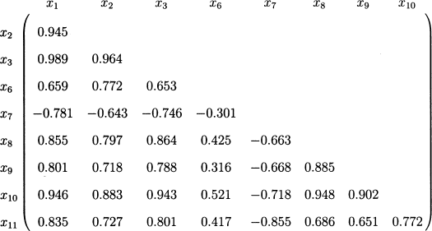
ASSUMPTION 2: MULTICOLLINEARITY IN ACTION
Multicorrelated variables
Correlation matrix
 | x1 | x2 | x3 | x6 | x7 | x8 | x9 | x10
x2 | 0.945
x3 | 0.989 | 0.964
x6 | 0.659 | 0.772 | 0.653
x7 | -0.781 | -0.643 | -0.746 | -0.301
x8 | 0.855 | 0.797 | 0.864 | 0.425 | -0.663
x9 | 0.801 | 0.718 | 0.788 | 0.316 | -0.668 | 0.885
x10 | 0.946 | 0.883 | 0.943 | 0.521 | -0.718 | 0.948 | 0.902
x11 | 0.835 | 0.727 | 0.801 | 0.417 | -0.855 | 0.686 | 0.651 | 0.772
Values of correlation matrix are correlation coefficients( r ).
For example, r=0.989 indicates very strong positive correlation between X1 & X3.
They explain almost same variance about dependent variable, thus introducing redundancy.
Multicorrelated variables
Keeping both X1 & X3 doesn’t add extra value to model.

Slide 39
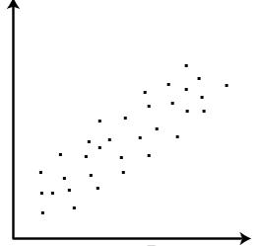
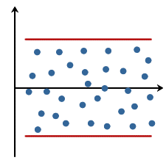
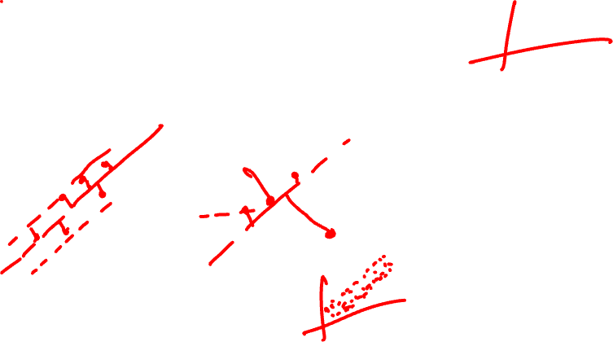
Homoscedastic implies constant variance
Homo means equal
Scedastic implies dispersion
ASSUMPTION 3:
WHAT IS HOMOSCEDASTICITY?

Slide 40
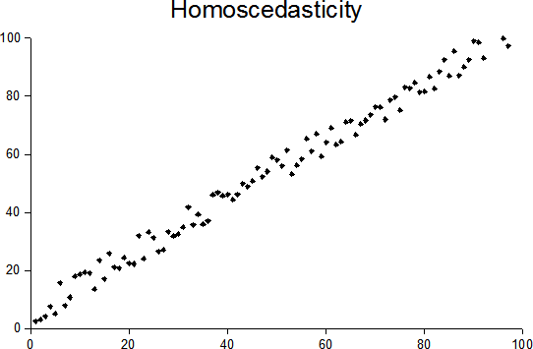

ASSUMPTION 3: RESIDUALS(ERRORS) ARE HOMOSCEDASTIC
Homoscedasticity
100
80
60
40
20
0
0
20
40
60
80
100
Spread of residual values is constant as we move along x-axis

Slide 41
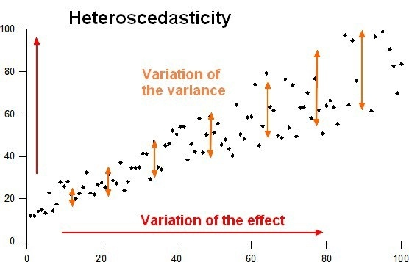
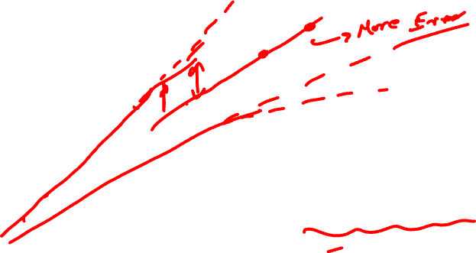
Heteroscedasticity
100
Variation of
the variance
80
ASSUMPTION 3: RESIDUALS(ERRORS) ARE HETEROSCEDASTIC
60
40
20
Variation of
the effect
0
0
20
40
60
80
100
Spread of residual values increases as we move along x-axis.

Slide 42
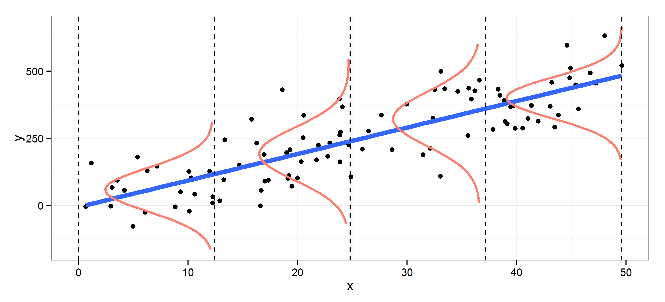

ASSUMPTION 4: NORMAL DISTRIBUTION OF RESIDUALS
Data points should be random and follow a normal distribution
500
y
250
0
0
10
20
x
30
40
50

Slide 43

ASSUMPTION 4: WHAT IF DISTRIBUTION OF RESIDUALS ARE NOT NORMAL?
Errors follows a curved pattern thus introducing bias.
Residuals
0
Independents

Slide 44
LOGISTIC REGRESSION

Slide 45









RELOOK AT SUPERVISED LEARNING WITH AN EXAMPLE
Profession
Income
Credit approved or rejected?
Savings
House type

Slide 46

RELOOK AT SUPERVISED LEARNING WITH AN EXAMPLE
Predicts specific quantity & category.
Has predictor(independent) variable(s) & an outcome(dependent) variable.
Profession | Income (permonth) | Savings (permonth) | House | Credit (Approved)
Techie | 45000 | 11000 | Rental | No
Techie | 56000 | 10000 | Own | Yes
Doctor | 85000 | 1800 | Own | Yes
Designer | 60000 | 8000 | Rental | Yes
Doctor | 120000 | 20000 | Own | Yes
Techie | 76000 | 16000 | Own | No
Teacher | 60000 | 25000 | Own | Yes
Doctor | 200000 | 40000 | Own | No
Predictor variables
Dependent variable
Profession
Income(Per Month)
Savings(Per Month)
House
Credit(Approved)

Slide 47


MORE EXAMPLES OF SUPERVISED LEARNING
Classification
Regression
Will it be Cold or Hot tomorrow?
What is the temperature going to
be tomorrow?
HOT
COLD
HOT
0
84
Classification
Regression
HOT
HOT
COLD
Predicted Temperature
Predicted Temperature
COLD
COLD

Slide 48




WHAT IS CLASSIFICATION ?
Predict categories of dependent variable(Output) using independent(Input) variable(s).
Will it rain tomorrow?
Will the flight arrive in time?
Will it rain tomorrow?
Will the flight arrive in time?

Slide 49



WHAT ARE ANSWERS TO BELOW QUESTIONS?
Will the battery last till end of the day?
How many hours
will battery last?
Will the
train be late?
How late will
the train arrive?

Slide 50



LOGISTIC REGRESSION FOR CATEGORIZATION
Type of classification technique whose underlying concept is based on linear regression to predict categories.
Given past data
Should we give loan to this customer?
Profession | Income (permonth) | Savings (permonth) | House | Credit (Approved)
Techie | 45000 | 11000 | Rental | No
Techie | 56000 | 10000 | Own | Yes
Doctor | 85000 | 1800 | Own | Yes
Designer | 60000 | 8000 | Rental | Yes
Doctor | 120000 | 20000 | Own | Yes
Techie | 76000 | 16000 | Own | No
Teacher | 60000 | 25000 | Own | Yes
Doctor | 200000 | 40000 | Own | No
Techie | 70000 | 20000 | Rental | ?

Slide 51






USE CASES OF LOGISTIC REGRESSION
Finance
Healthcare
Engineering
Can credit be approved?
Dr. am I diabetic?
Will the machine work after 6 months?

Slide 52
Dependent variable doesn’t need to be correlated with independent variables.
No normality assumption of dependent variable
There is no homogeneity of variance assumption.
Normal distribution of errors is not assumed.
Tree-based & other algorithms may have higher accuracy but logistic regression is used preferably in probability-based solution.
BENEFITS OF LOGISTIC REGRESSION

Slide 53





CAN LINEAR REGRESSION HELP US IN THIS SCENARIO?
If we use Linear Regression the line incorrectly divides a single category into two.
If we use Linear Regression the line incorrectly divides a single category into two.
Income | Loan (Approved)
74000 | 1
43555 | 0
65000 | 1
34555 | 0
90000 | 1
23456 | 0
65432 | 1
70200 | 1
42000 | 0
85000 | 1
19900 | 0
95500 | 1
100000 | 1
27500 | 0
1.2
 |  |  | 1 1 1 | 1 1 1 1
1
0.8
Probability needs to between 0 & 1
0.6
Probability
needs to
between 0 & 1
Loan(Approved)
0.4
0.2
0
0
20000
40000
60000
80000
100000
120000
Income
Threshold
Threshold
No, Linear Regression can’t predict value of categorical variable.
The line drawn doesn’t capture any information about outcome variable.

Slide 54



CHALLENGES WITH LINEAR FUNCTION TO PREDICT PROBABILITY
Output becomes greater than 1 & less than 0.
This violates the rule of probability.
b0 | b1 | X(Income(in $1000s)) Output(p(y)=b0+b1*X)
-1.7 | 0.064 | 34 | 0.476
 |  | 25 | -0.1
 |  | 40 | 0.86
 |  | 43 | 1.052
 |  | 45 | 1.18
 |  | 48 | 1.372
 |  | 22 | -0.292
p(y)=ẞ₀+ẞ₁X
It didn’t work

Slide 55

LOGISTIC REGRESSION: A SOLUTION TO CLASSIFICATION
Logistic Regression helps us when output variable is categorical.
Transforms Linear Function to a function that can predict categories with probabilities.
Income | Loan (Approved)
74000 | 1
43555 | 0
65000 | 1
34555 | 0
90000 | 1
23456 | 0
65432 | 1
70200 | 1
42000 | 0
85000 | 1
19900 | 0
95500 | 1
100000 | 1
27500 | 0
Linear regression
Logistic regression
y=1
y=1
y
y
Predicted Y can exceed
0 and 1 range
Predicted Y lies within
0 and 1 range
y=0
y=0
X
X

Slide 56



HELP OF LOGISTIC REGRESSION: IT’S ALL ABOUT PROBABILITY
Will Home Loan be approved?
Income Loan(Approved)
Logistic Regression always outputs a probability value to assign observations to classes.
Income | Loan (Approved)
74000 | 1
43555 | 0
65000 | 1
34555 | 0
90000 | 1
23456 | 0
65432 | 1
70200 | 1
42000 | 0
85000 | 1
19900 | 0
95500 | 1
100000 | 1
27500 | 0
54000 | ?
Will Home Loan be approved?
Yes(0.78) No(0.22)
(p)
(1-p)
Yes(0.78) No(0.22)
(p)
(1-p)

Slide 57



HELP OF LOGISTIC REGRESSION: FULFILL THE CRITERIA
Assigning observations to classes(Yes(1)/No(0)) depends on threshold probability.
1.0
P = 0.78
p=0.78
0.8
Loan approved
0.6
Loan approved
Probability
0.4
Loan not approved
0.2
Loan not approved
0.0
5
20
25
30
35
40
45
50
20 25 30 35 40 45 50
Income(in $1000s)
Income (in $1000s)
Threshold probability(0.5)
Threshold probability(0.5)

Slide 58

LET’S UNDERSTAND LOGISTIC REGRESSION MATHEMATICALLY: ODDS RATIO
Logistic Regression can be written in terms of odds ratio.
Odds ratio=probability of event occurring / probability of event not occurring.
Example(Odds ratio):
Ratio of probability of black horse winning
To
probability of not winning.

Slide 59


LET’S UNDERSTAND LOGISTIC REGRESSION MATHEMATICALLY: ODDS RATIO
Will Home Loan be approved?
Will Home Loan be approved?
p
Odds ratio =
1-p
Applying Odds ratio on Loan Approved example,
0.78
Odds of loan being approved is
= 3.54.
0.22
Yes(0.78) No(0.22)
(p)
(1-p)
Yes(0.78) No(0.22)
(p)
(1-p)

Slide 60


LET’S UNDERSTAND LOGISTIC REGRESSION MATHEMATICALLY: LOGIT FUNCTION
Logit or Sigmoid function :
Transformation of Linear Function into non-linear function that predicts categories.

Slide 61


LET’S BREAK LOGIT FUNCTION INTO PROBABILITY
This is also called sigmoid function that is used to predict probability to assign observations to categories

Slide 62
LET US RECAP WHY LINEAR REGRESSION CAN NOT BE USED IN CLASSIFICATION?
If we use Linear Regression the line incorrectly divides a single category into two.
1.2
 |  |  | 111 | 1111
1
0.8
0.6
Probability
needs to
between 0 & 1
Loan(Approved)
0.4
0.2
0
0
20000
40000
60000
80000
100000
120000
Income
If we use Linear Regression the line incorrectly divides a single category into two.
If we use Linear Regression the line incorrectly divides a single category into two.
Income | Loan (Approved)
74000 | 1
43555 | 0
65000 | 1
34555 | 0
90000 | 1
23456 | 0
65432 | 1
70200 | 1
42000 | 0
85000 | 1
19900 | 0
95500 | 1
100000 | 1
27500 | 0
1.2
 |  |  | 1 1 1 | 1 1 1 1
1
0.8
0.6
Probability needs to between 0 & 1
Probability
needs to
between 0 & 1
Loan(Approved)
0.4
0.2
0
0
20000
40000
60000
80000
100000
120000
Income
Threshold
Threshold
No, Linear Regression can’t predict value of categorical variable.
The line drawn doesn’t capture any information about outcome variable.

Slide 63




HOW SIGMOID CURVE SOLVES CATEGORIZATION PROBLEM?
Loan (Approved)
1
Income | Loan(Approved)
74000 | 1
43555 | 0
65000 | 1
34555 | 0
90000 | 1
23456 | 0
65432 | 1
70200 | 1
42000 | 0
85000 | 1
19900 | 0
95500 | 1
100000 | 1
27500 | 0
1.2
0.9
1
0.8
0.7
0.8
0.6
Loan
(Approved)
0.5
0.6
0.4
0.4
0.3
0.2
0.2
0.1
Income
0
0
0
20000
40000
60000
80000
100000
120000
0
2
4
6
8
10
12

Slide 64
OVERCOME CHALLENGES POSED BY LINEAR FUNCTION FOR CLASSIFICATION
Challenges with Linear function(ẞ₀+ẞ₁X) to predict probability
Outputs can have values less than 0 or greater than 1.
This violates the rule of probability.
Don’t worry
We can fix probability issues(p<0,p>1) with 2 steps.

Slide 65



STEP 1:REMOVAL OF NEGATIVE VALUES
Taking exponent of linear function always returns positive value.
Thus we can get rid of negative infinity to 0.
Taking exponent of linear function always returns positive value.
Thus, we can get rid of negative infinity to 0.
b0 | b1 | X(income (in $ 1000s)) | Output: p(y)=b0+b1*X) | p(y)=exp
 |  | 34 | 0.476 | 1.61
 |  | 25 | -0.1 | 0.92
 |  | 40 | 0.86 | 2.36
-1.7 | 0.064 | 43 | 1.052 | 2.86
 |  | 45 | 1.18 | 3.25
 |  | 48 | 1.372 | .394
 |  | 22 | -0.292 | 0.75
 |  | 23 | -0.228 | 0.80
b0=b1*X
Now let us see how to limit value from 0 to 1.
Now let us see how to limit value from 0 to 1.

Slide 66



STEP 2: BRING RANGE OF VALUES BETWEEN 0 AND 1
Dividing a number by a number slightly greater than the actual number gives value smaller than actual value.
Dividing a number by a number slightly greater than the actual number gives value smaller than actual value.
b0 | b1 | X(income (in $ 1000s)) | Output: p(y)=b0+b1*X | p(y)=exp | p(y)=exp /1+exp
 |  | 34 | 0.476 | 1.61 | 0.62
 |  | 25 | -0.1 | 0.92 | 0.48
 |  | 40 | 0.86 | 2.36 | 0.70
-1.7 | 0.064 | 43 | 1.052 | 2.86 | 0.74
 |  | 45 | 1.18 | 3.25 | 0.76
 |  | 48 | 1.372 | .394 | 0.80
 |  | 22 | -0.292 | 0.75 | 0.43
 |  | 23 | -0.228 | 0.80 | 0.44
b0=b1*X
b0=b1*X
b0=b1*X

Slide 67

STEP 2: NOW BRING THE PROBABILITY BETWEEN 0 AND 1
Equation above gives probability between 0 & 1.
As a result, it fulfills the criteria of assigning observations to classes with probability.

Slide 68


LET US DO A QUICK RECAP OF LINEAR FUNCTION
Income | House Price (In Lakh)
74000 | 38
43555 | 24
65000 | 32
34555 | 18
90000 | 45
23456 | 14
65432 | 30
70200 | 35
42000 | 28
85000 | 40
19900 | 12
95500 | 50
100000 | 60
27500 | 20
House Price (In Lakh)
70
60
60
50
50
45
40
38
40
32
35
28
30
30
House Price (In Lakh)
20
24
20
18
12
14
10
0
0
20000
40000
60000
80000
100000
120000
Income
12
Prediction is in form of linear function (Y=mx+c).

Slide 69


LET US DO A QUICK RECAP OF LOGISTIC FUNCTION
1
Loan ( Approved )
1.2
1
1
1
1
1
1
1
1
Loan
( Approved )
0.8
0.6
0.4
0.2
Income
0
20000
40000
60000
80000
100000
120000
The prediction is transformed into a non-linear function ,often called Logit function/sigmoid function.
The prediction is transformed into a non linear function ,often called Logit function/sigmoid function.

Slide 70


WHAT IS CLASSIFICATION ACCURACY?
Classification accuracy is number of correct predictions made divided by total number of predictions.
Number of correct prediction
Accuracy =
Total number of predictions

Slide 71



LET’S HAVE A LOOK AT SAM’S EMAIL ACCOUNT
Email account contains a total of 10000 emails with 9671 genuine emails and 329 spam emails.
Email
Email
……..
……
@
@
@
@
Ham
Spam
Ham
Spam
9671
329
9671
329

Slide 72

LET’S BUILD A SPAM CLASSIFIER MODEL
After passing email data through the model we correctly classify 9544 emails as ham and 160 emails as spam.
Email
Email
@
@
@
……..
……..
……
Ham
Spam
Ham
Spam
9544
160
9544
160
9544+160
Accuracy =
= 97.04%
10000

Slide 73








ISSUES WITH CLASSIFICATION ACCURACY
Dumb Model: Predict all are ham
Original Model
Dumb Model: Predict all are ham
Original Model
@
…
@
…
@
...
@
…
…
…
...
…
Ham
Spam
Ham
Spam
Ham
Spam
Ham
Spam
9671
329
9544
160
9671
329
9544
160
9671
9544+160
Accuracy =
= 96.71%
Accuracy =
= 97.04%
10000
10000
It is evident that accuracy for a dumb model is not much different from our original model.
It is evident that accuracy for a dumb model is not much different from our original model.

Slide 74

LET’S DO SOME HANDS-ON!

